Slide 1
Object Oriented Design System Modeling
Part-1

Slide 2
Topics covered
Context models
Interaction models
Structural models
Behavioral models

Slide 3
System modeling
System modeling is the process of developing abstract models of a system, with each model presenting a different view or perspective of that system.
System modeling has now come to mean representing a system using some kind of graphical notation, which is now almost always based on notations in the Unified Modeling Language (UML).
System modelling helps the analyst to understand the functionality of the system and models are used to communicate with customers.

Slide 4
Existing and planned system models
Models of the existing system are used during requirements engineering. They help clarify what the existing system does and can be used as a basis for discussing its strengths and weaknesses. These then lead to requirements for the new system.
Models of the new system are used during requirements engineering to help explain the proposed requirements to other system stakeholders. Engineers use these models to discuss design proposals and to document the system for implementation.

Slide 5
System perspectives
An external perspective, where you model the context or environment of the system.
An interaction perspective, where you model the interactions between a system and its environment, or between the components of a system.
A structural perspective, where you model the organization of a system or the structure of the data that is processed by the system.
A behavioral perspective, where you model the dynamic behavior of the system and how it responds to events.

Slide 6
UML diagram types
Activity diagrams, which show the activities involved in a process or in data processing .
Use case diagrams, which show the interactions between a system and its environment.
Sequence diagrams, which show interactions between actors and the system and between system components.
Class diagrams, which show the object classes in the system and the associations between these classes.
State diagrams, which show how the system reacts to internal and external events.

Slide 7
Use of graphical models
As a means of facilitating discussion about an existing or proposed system
Incomplete and incorrect models are OK as their role is to support discussion.
As a way of documenting an existing system
Models should be an accurate representation of the system but need not be complete.
As a detailed system description that can be used to generate a system implementation
Models have to be both correct and complete.

Slide 8
Context models
Context models are used to illustrate the operational context of a system - they show what lies outside the system boundaries.
Social and organisational concerns may affect the decision on where to position system boundaries.
Architectural models show the system and its relationship with other systems.

Slide 9
System boundaries
System boundaries are established to define what is inside and what is outside the system.
They show other systems that are used or depend on the system being developed.
The position of the system boundary has a profound effect on the system requirements.
Defining a system boundary is a political judgment
There may be pressures to develop system boundaries that increase / decrease the influence or workload of different parts of an organization.

Slide 10
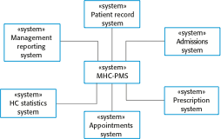
The context of the MHC-PMS

Slide 11
Process perspective
Context models simply show the other systems in the environment, not how the system being developed is used in that environment.
Process models reveal how the system being developed is used in broader business processes.
UML activity diagrams may be used to define business process models.

Slide 12
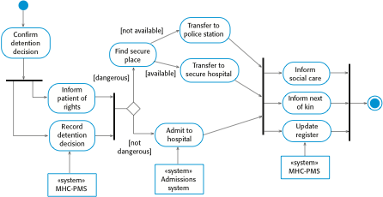
Process model of involuntary detention

Slide 13
Thank You!

